Slide 1
16th Joe A. and Nancy Vaughn Stalcup Lecture on Christian Unity
Brite Divinity School, Fort Worth TX
Changing Structures, Shifting Spheres of Influence – Setting a New Path for Christian Unity.
June 12, 2021: 11 AM-1 PM ED Online
The Global Christian Forum Story: A New Ecumenism
The Reverend Dr. Casely Baiden Essamuah, Secretary, GCF, since 2018
caselyessamuah@globalchristianforum.org

Slide 2
State of Christian Denominations in the World
45000 denominations and counting . . .
Ephesians 4:1-6, 12-13
Unity and Maturity in the Body of Christ
4 As a prisoner for the Lord, then, I urge you to live a life worthy of the calling you have received. ² Be completely humble and gentle; be patient, bearing with one another in love. ³ Make every effort to keep the unity of the Spirit through the bond of peace. ⁴ There is one body and one Spirit, just as you were called to one hope when you were called; ⁵ one Lord, one faith, one baptism; ⁶ one God and Father of all, who is over all and through all and in all . . .
, ¹² to equip his people for works of service, so that the body of Christ may be built up ¹³ until we all reach unity in the faith and in the knowledge of the Son of God and become mature, attaining to the whole measure of the fullness of Christ.

Slide 3
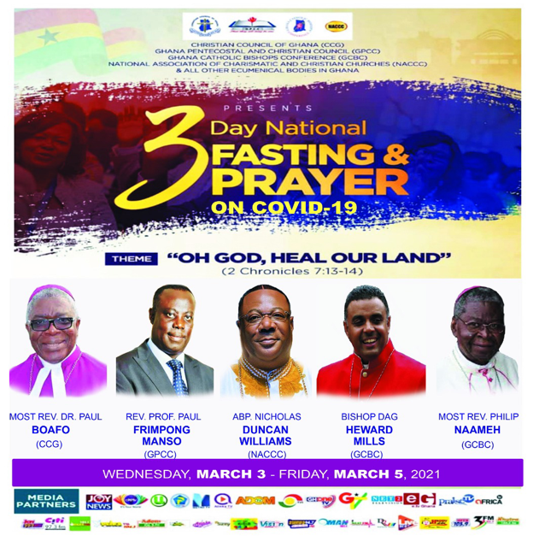
Global South Example
Christian Council of Ghana
Ghana Pentecostal and Charismatic Council
National Association of Christians and Charismatic Churches of Ghana
Ghana Charismatic Bishops Conference
Ghana Catholic Bishops Conference

Slide 4
Origins of Global Christian Forum, 1998
Growth of Christianity in China
Re-emergence of Christianity in former Communist countries
Multiplication of autonomous Christian denominations
Rising secularization in the Western cultures
Increasing awareness of religious pluralism
Continuing suffering of the church in diverse settings
Demographic center shift to the Global south
Rise of modern Pentecostal and Charismatic movements

Slide 5
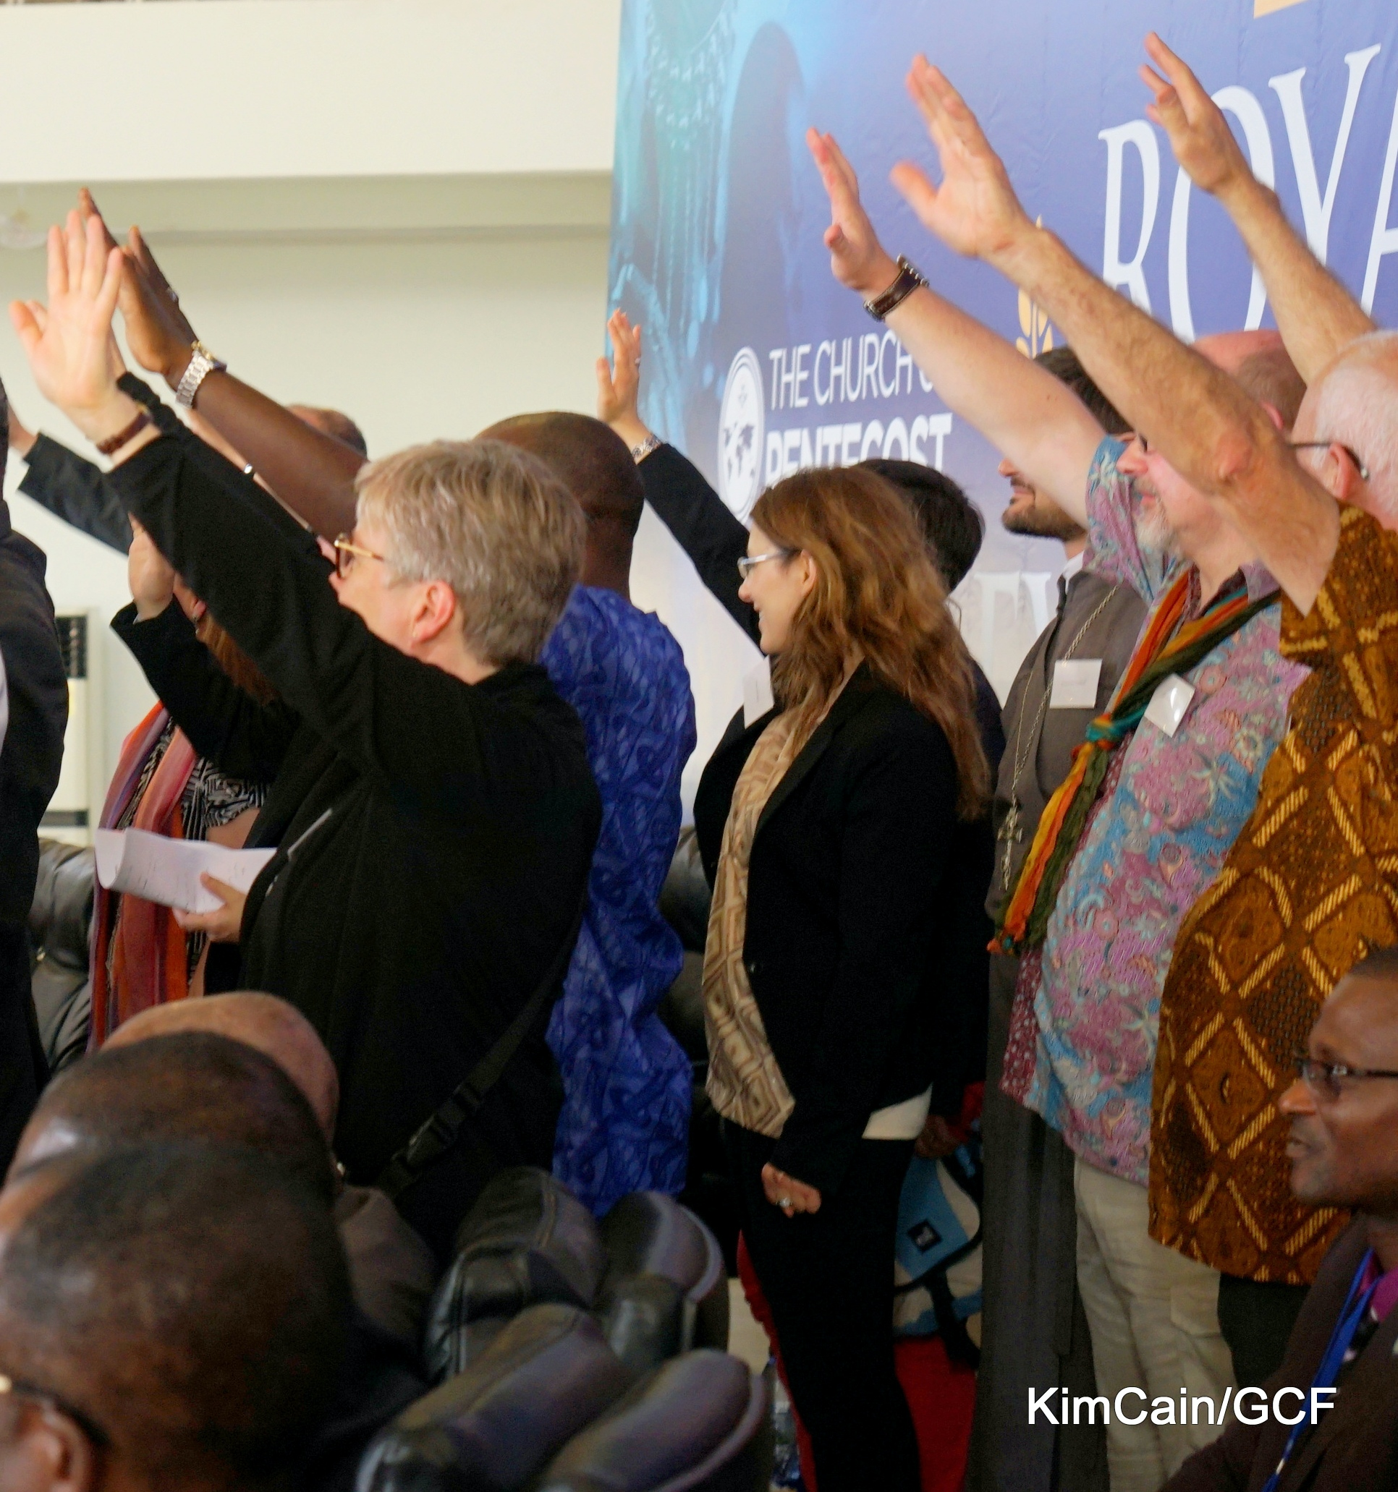
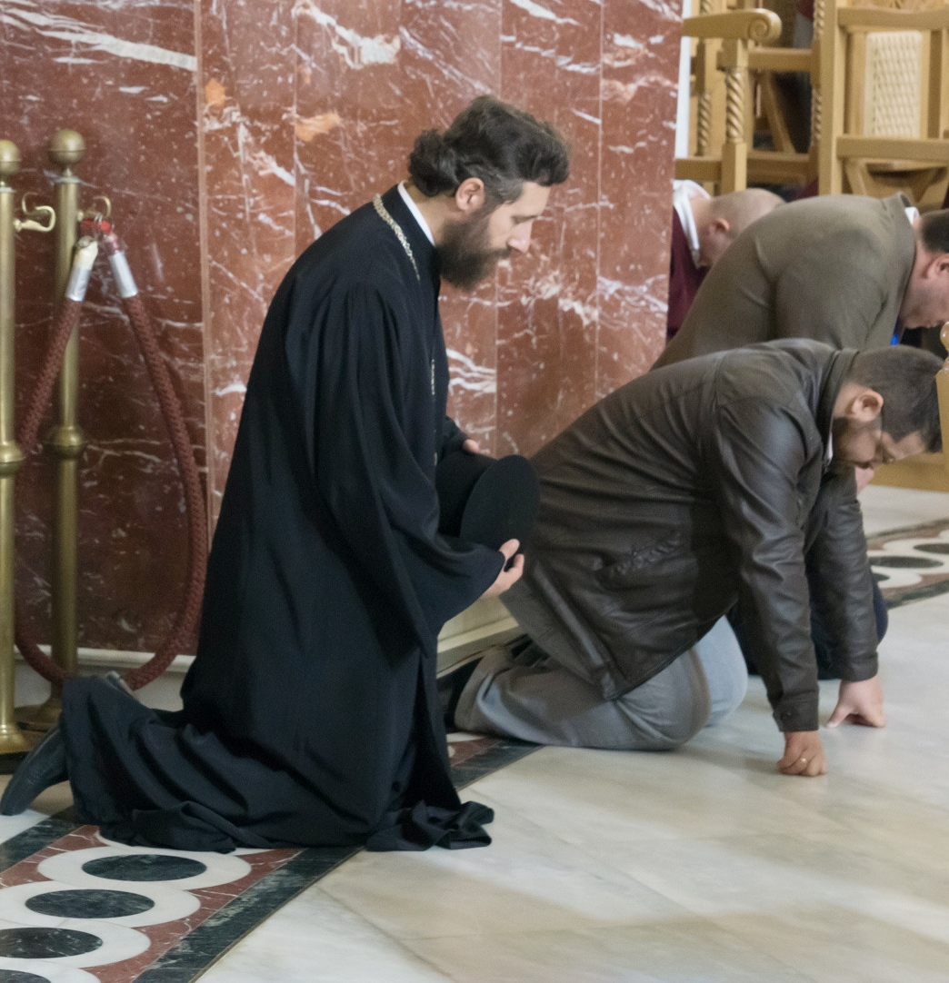
Challenge to Christian Unity
Many of the so called “younger” churches driving the changes and reshaping world Christianity were not associated with the historical ecumenical movement. Full of spiritual vitality, driven by mission, and inspired by an expansive vision, most of them maintained great distance from the “older” churches.
At the same time, the older churches doubted the legitimacy and orthodoxy of the newer churches.

Slide 6
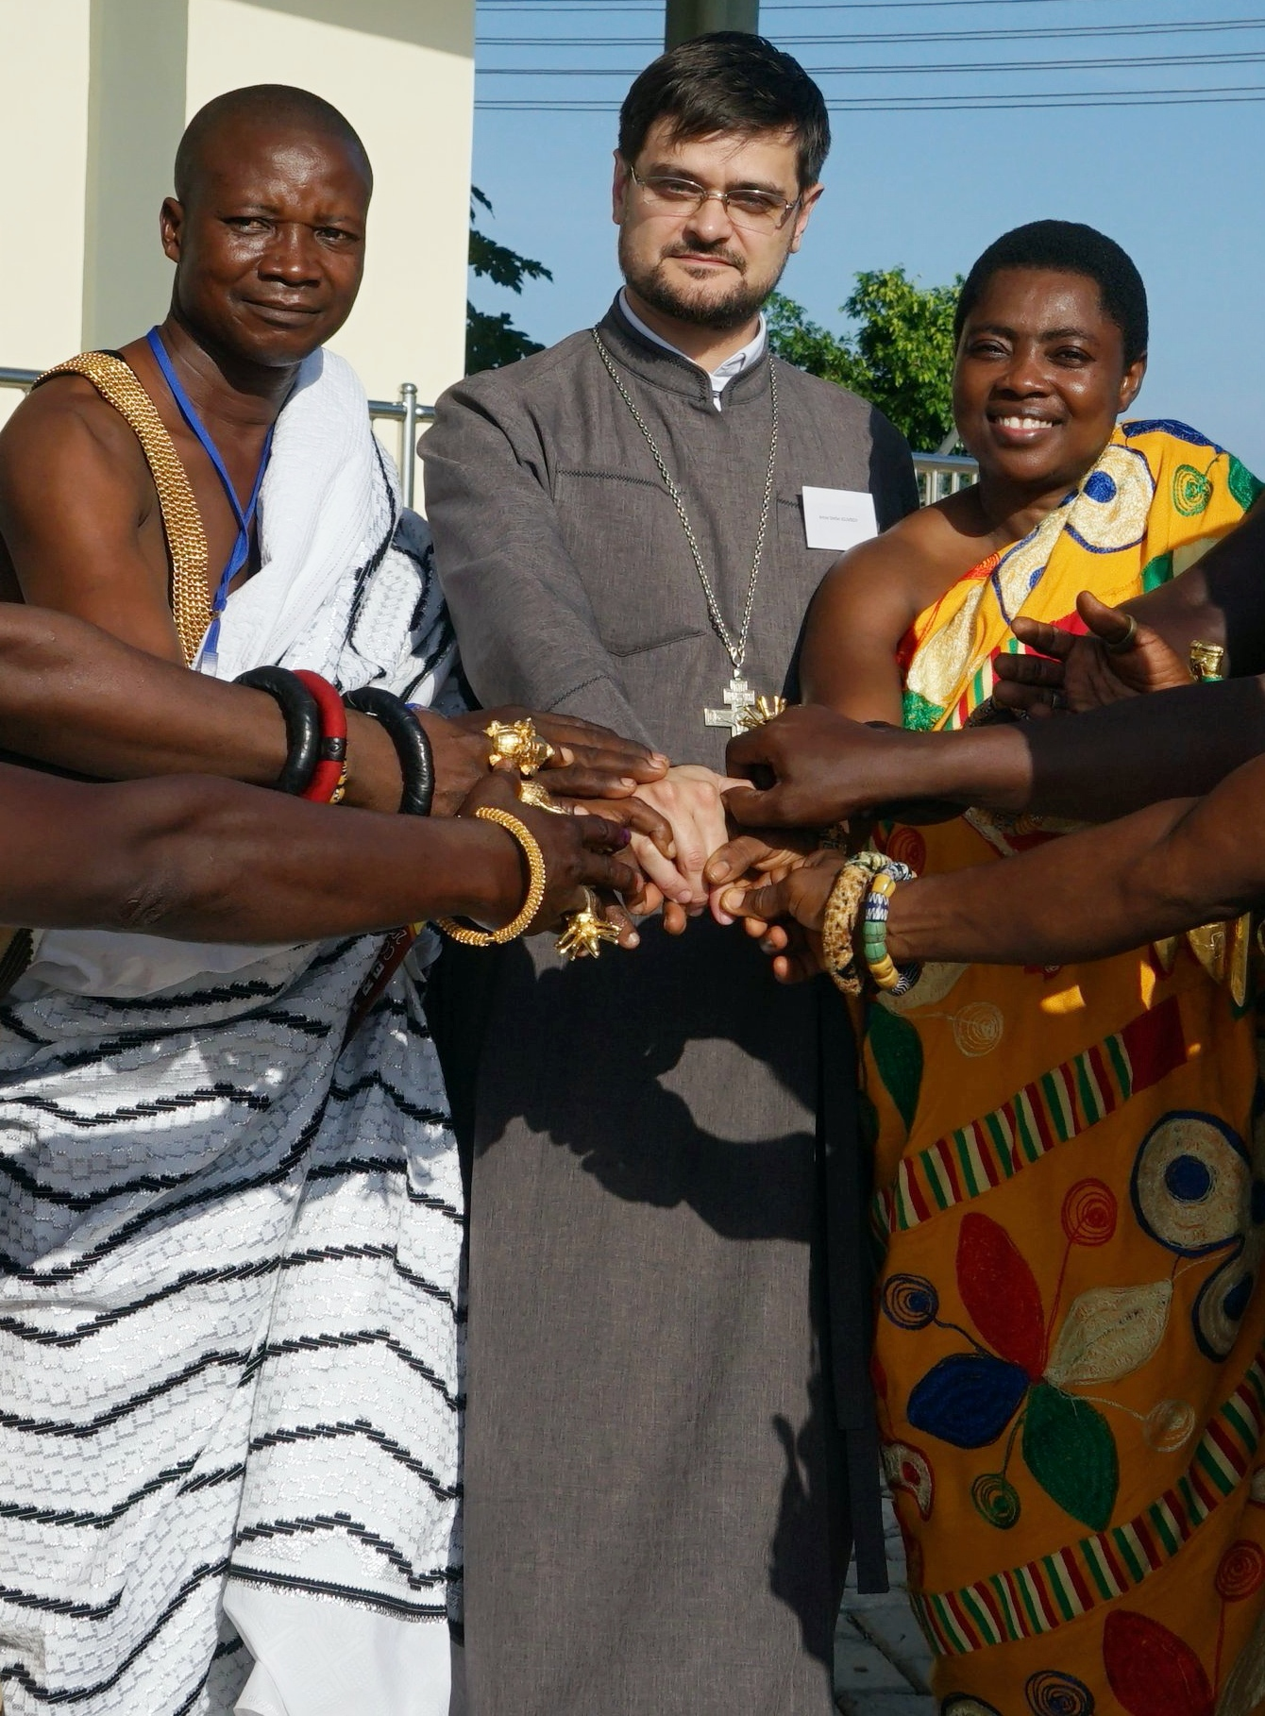
Normative Ecumenism Then
Dialogue around theological differences searching for points of convergence and agreement.
Cooperation around common challenges in society and the world such as immigration, climate change, health etc.
Dialogue and potential cooperation around engagement in God’s mission and evangelism.

Slide 7
New Trends
Not belaboring on what divides us, but WHO unites us
Ecumenism not as a luxury for the few but as a necessity for all
No one is safe until all are safe

Slide 8
Why Forum?
Participation is more important than membership.
Open to all bodies and organizations that confess Jesus Christ as Lord and Savior and seek to be obedient to God’s call.
Create space for genuine exchange about challenges facing the churches and where possible cooperation can flourish.
Should not become another institution, with administrative and bureaucratic structures.
Not a framework where decisions are to be taken or resolutions passed.
Instead, shape a network of relationships transcending limitations of existing arrangements.
The World Council of Churches would participate in the Forum alongside other partners without claiming any privileged place.

Slide 9
Why GCF?
Major shifts in global Christianity, whereby the expanding edge of the church has moved from the global North (primarily Protestant and Catholic Europe and North America) to the global South (Africa, Asia and Latin America through the growth of Pentecostal, evangelical and charismatic churches).
The historic ecumenical movement is looking for creative ways forward. [Some have called this period “an ecumenical winter.”] The GCF provides space for exploration of expressions of Christian unity previously unavailable due to limited contact or past wounds.
GCF does not seek to replace that which has been achieved through the careful and prayerful work of the churches in dialogue and common theological discernment.
Rather, we hope instead to build on growing trust and mutual respect in order to be a truly open space where we can continue together our journey with Christ.

Slide 10
Guiding Purpose Statement for GCF
The Global Christian Forum (GCF) is a unique gathering of global Christian churches and organisations bringing together all the major streams of world Christianity. The GCF is an open space where all Christians can meet to nurture unity by fostering mutual respect and understanding as well as by addressing together common challenges.

Slide 11
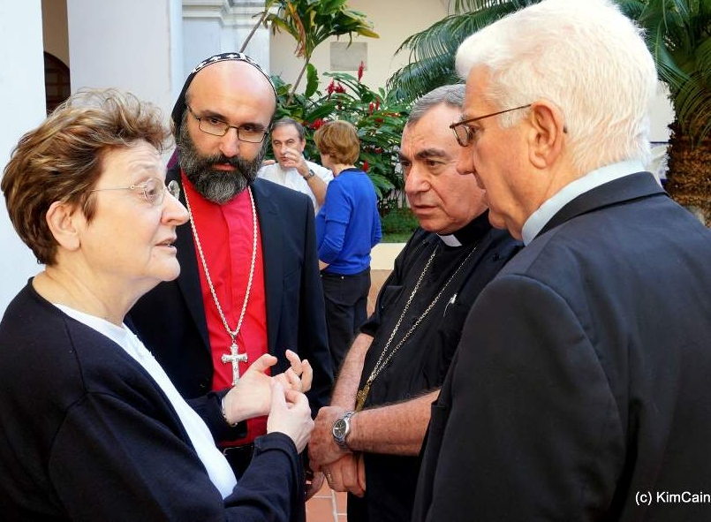
Uniqueness of GCF (1)
Our vision is expansive vision, and what makes us unique can be summarized under these 5 headings:
  We’ve introduced a new ecumenical method – didn’t intend that; a new model of how make the entry; to engage in ecumenical relationships; whereas previous models start with theological difference or common denominator of social order or doing things together. We start with Relationships. We prioritize and put a high premium on knowing each other well.

Slide 12
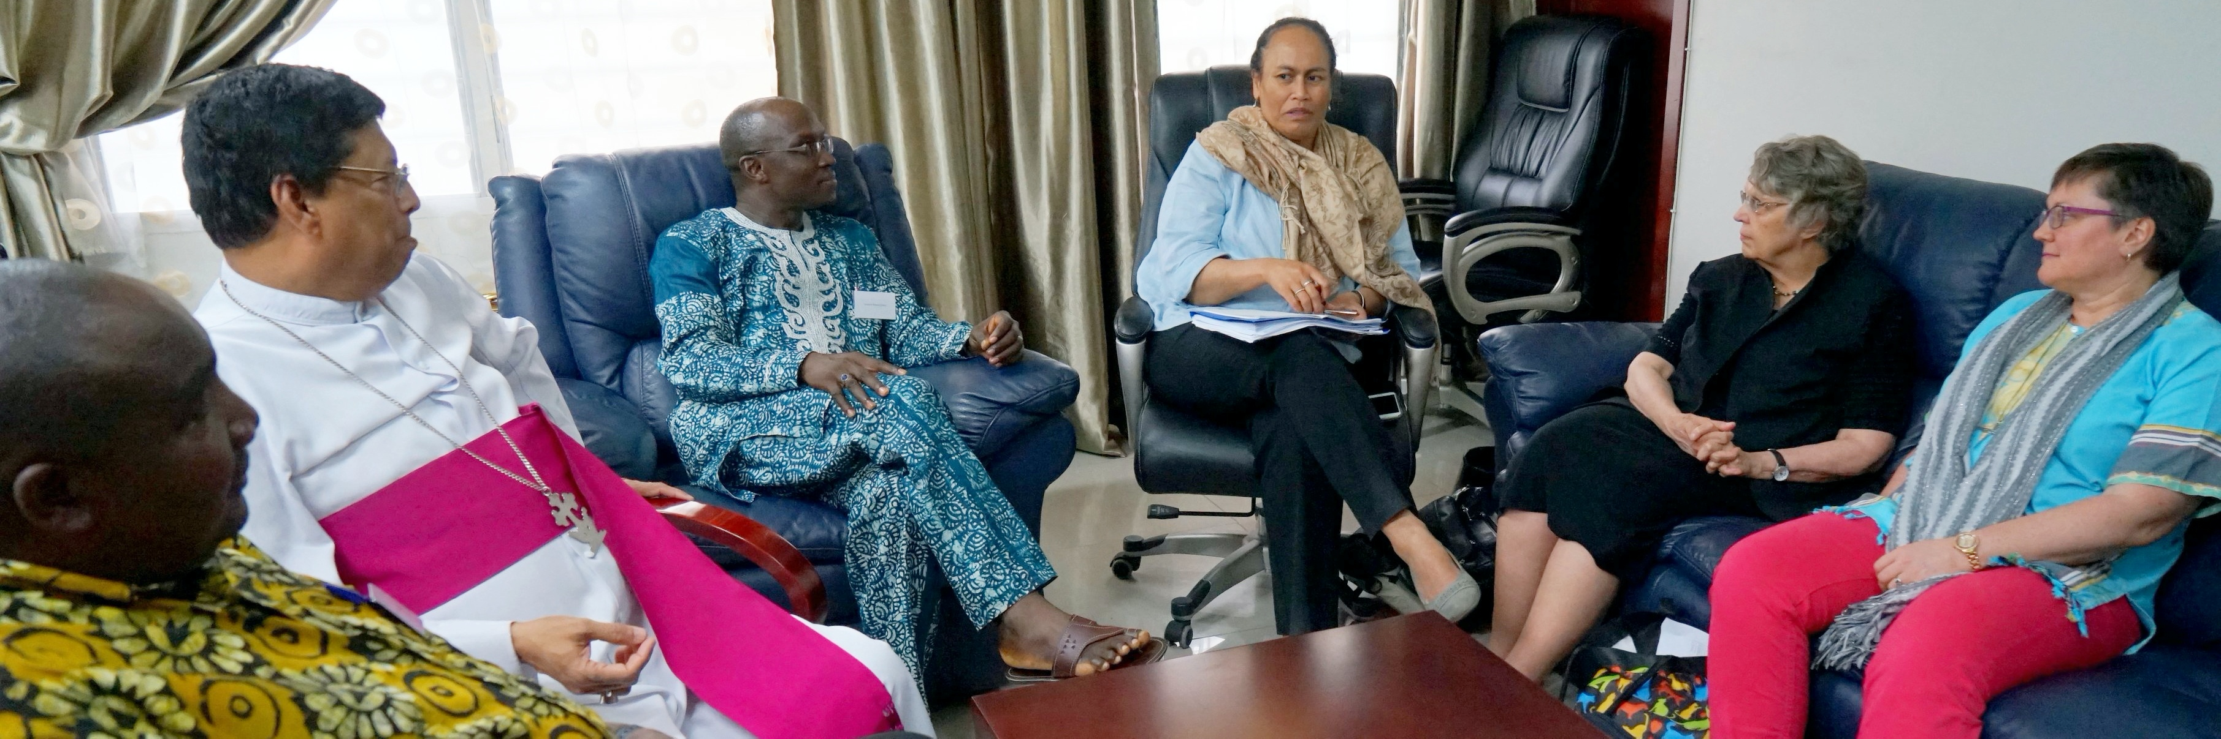
Uniqueness of GCF (2)
Provided evidence for groups that previously did not engage in ecumenical or interchurch relationships – we have opened up new avenues in remarkable ways through the sharing of Faith-Stories.

Slide 13
Faith Stories
When you give an honest account of how your life was encountered by Jesus Christ, and how that encounter has brought you to your present vocation and ministry, the witness of a Sri Lankan Catholic Bishop, a Pentecostal pastor from Peru, a bearded Coptic monk from Los Angeles, a Bolivian Baptist catechist and a Methodist nurse from Norway, or an Anglican woman bishop from Canada, sound remarkably the same.
Robert Gribben, Australian Methodist, in his article, The Future of Christianity?

Slide 14
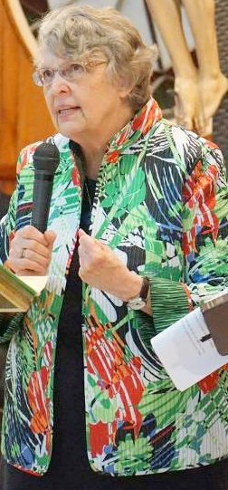
What do you do differently from the others?
Indeed, the special charism of GCF is the sharing of faith-stories. As Dr. Kathryn Johnson puts it, “every Christian has his or her relationship with Jesus Christ, every Christian life is a journey with Jesus. Telling that story is a way of introducing ourselves to each other, Christian to Christian.”
The beauty of sharing faith stories is that it enriches both the one telling the story and the one listening. Dr. Kathryn Johnson continues, “we are invited at this gathering to listen as if we do not already know, to listen generously with open hearts, minds and spirits; to listen with our theological disquiets momentarily set aside; to listen for the surprising work of the Spirit of God . . . We each listen with our ears open to the faithfulness which that perspective expresses, listening for Christ’s presence where it was not expected to be”

Slide 15
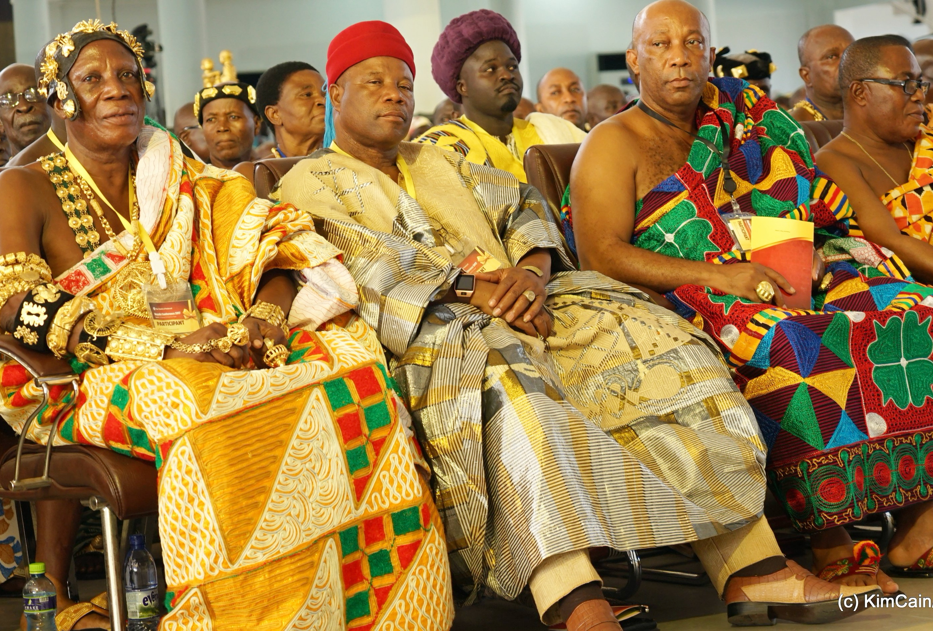
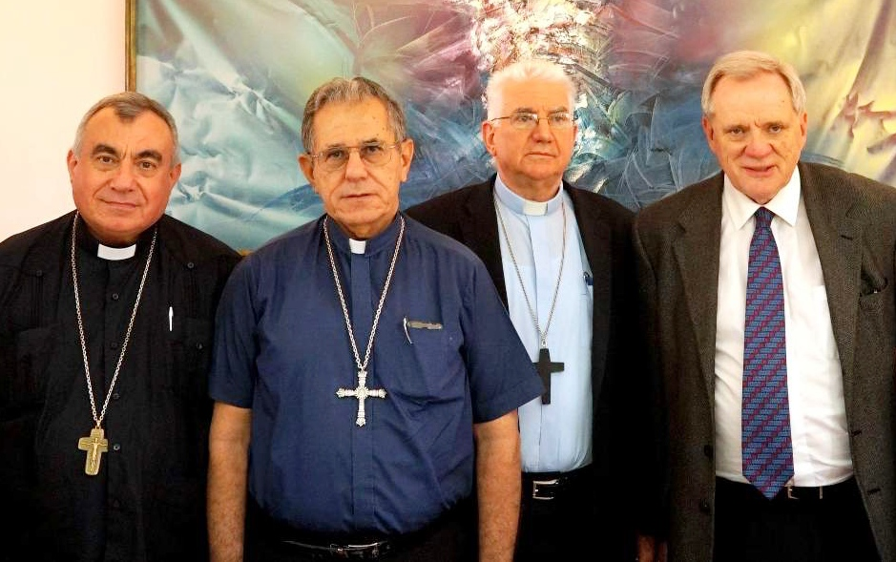
Uniqueness of GCF (3)
Come up with this distinction between historic churches and younger churches – 50%/50% - very first time saying that 50% will come from those with traditions not previously engaged.

Slide 16
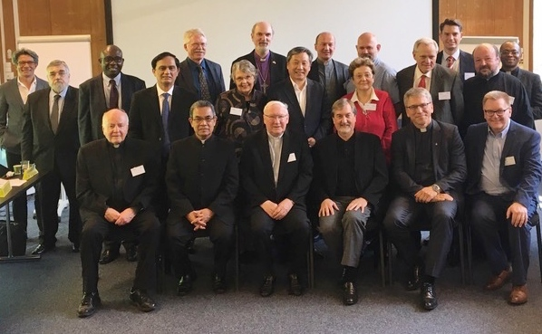
Uniqueness of GCF (4)
Established a common table – where what we call the 4 pillars – another dimension that has emerged in our work: PCPCU, WEA, PWF, WCC can sit together, commonly and equally . . . for instance, we gathered in Bossey 2017, heads of churches. First time in history that those 4 heads had ever met together.

Slide 17
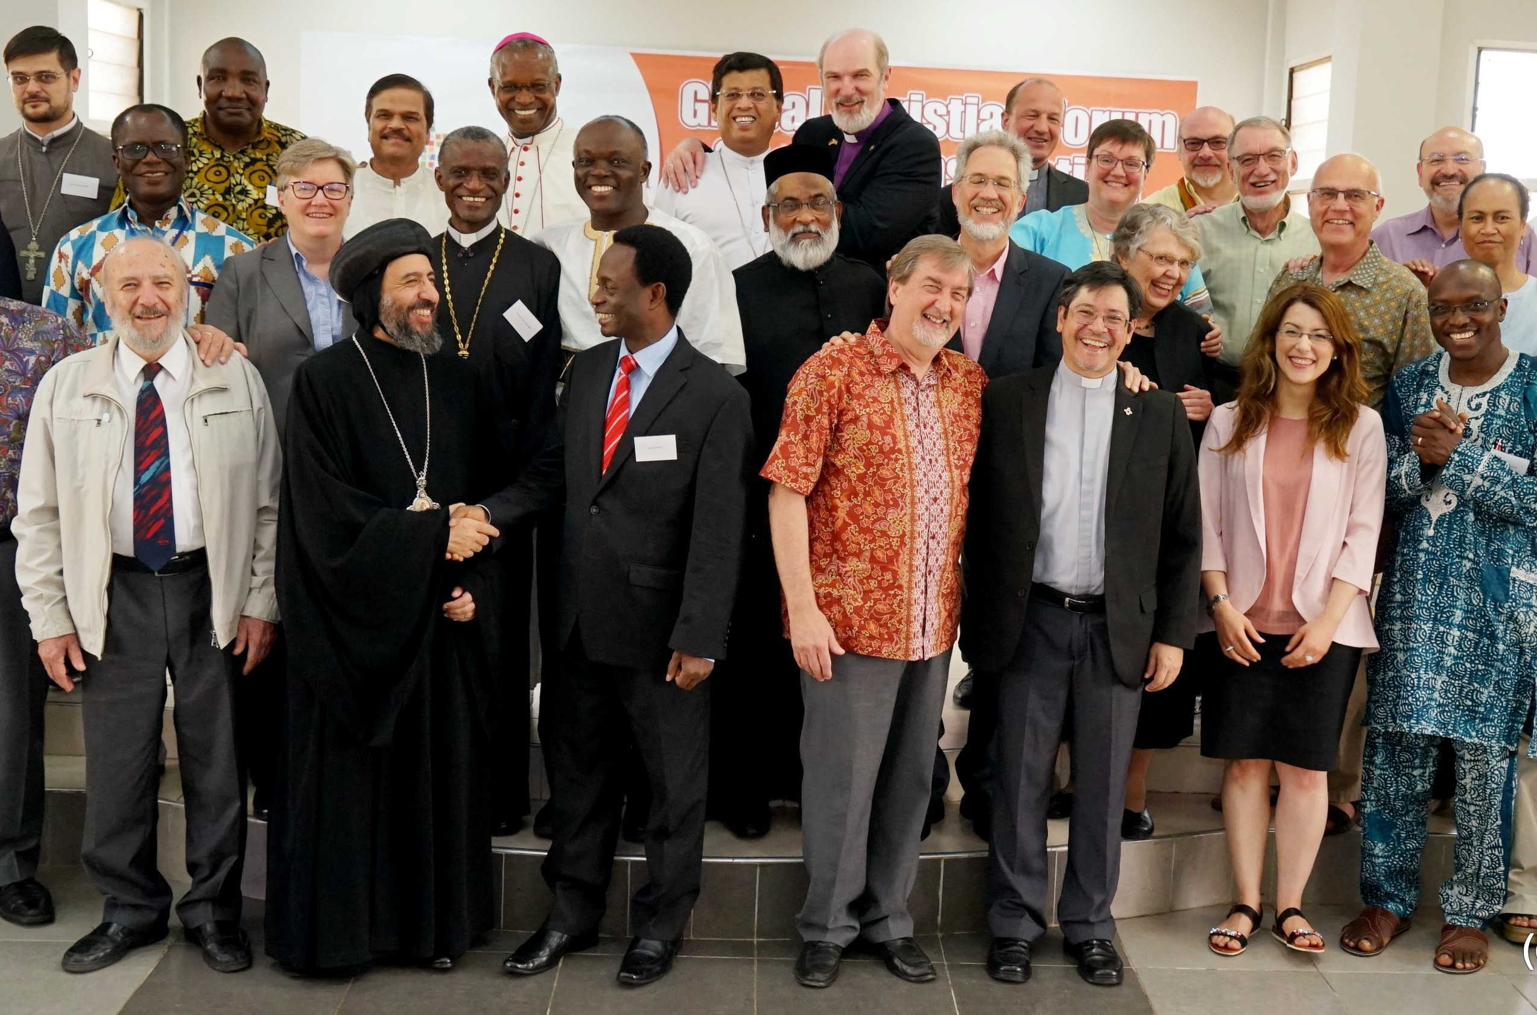
Uniqueness of GCF (5)
We’ve experimented with a model of participation rather than membership that broadens the category of who can participate so it is NOT limited to these pillars – important as they are, the circumference is larger and reflects the emerging landscape of global Christianity.

Slide 18
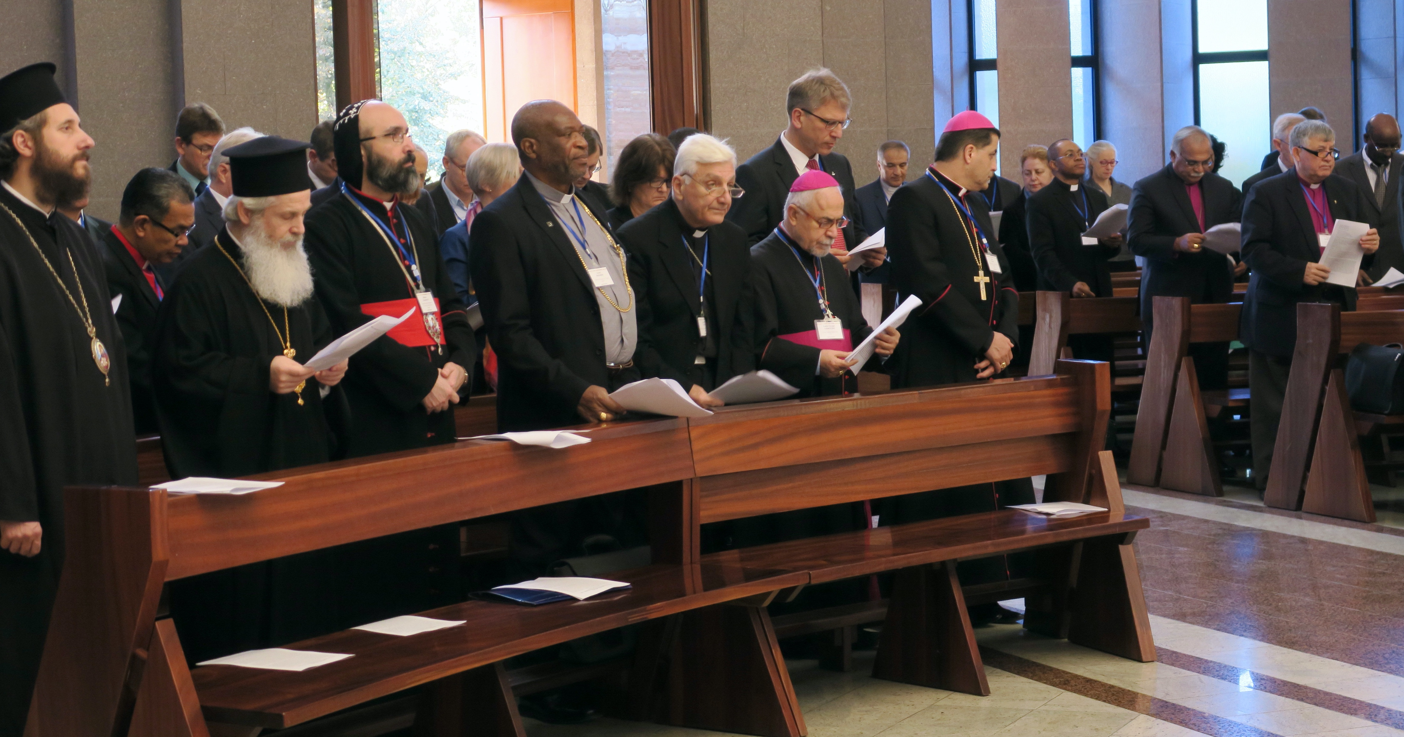
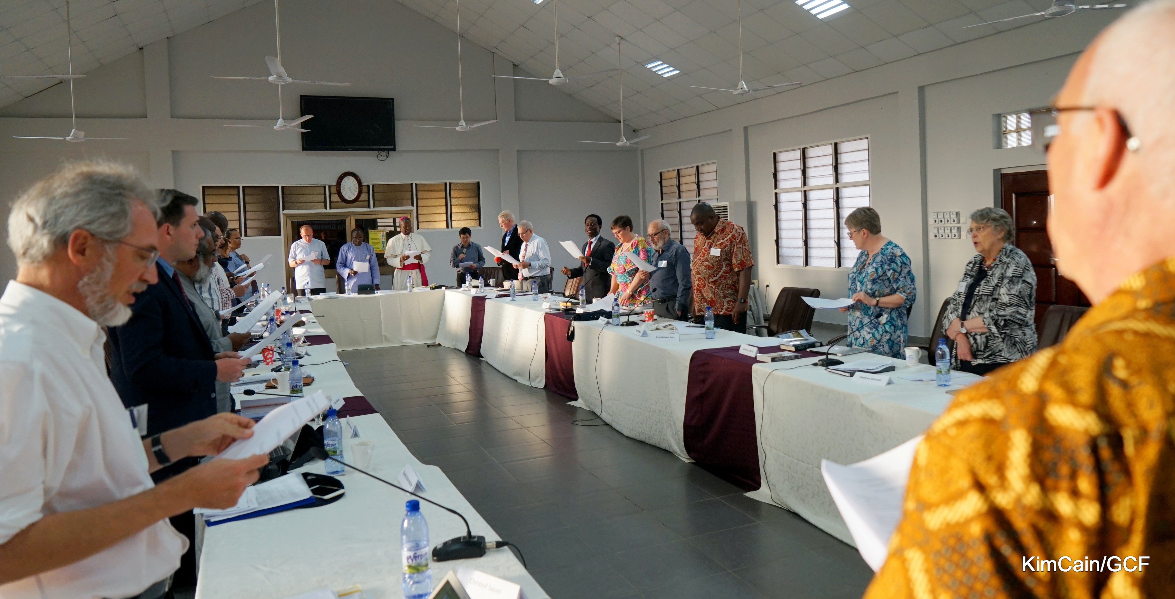
Facing Common Challenges Together
Call to Mission, Perceptions of Proselytism: A Global Conversation Accra, Ghana Jun 2017
Discrimination, Persecution, Martyrdom: Following Christ Together, Tirana, Albania Nov 2015

Slide 19

Expectation
The Forum process is conducted with the expectation that, when those who participate come to recognize Christ in one another, and one another in Christ, then there will also be recognition of the sharing of an unbreakable bond which is not of our making, but God’s.
I pray that your partnership with us in the faith may be effective in deepening your understanding of every good thing we share for the sake of Christ. Philemon 1:6

Slide 20
Too Important Not To Do It Together
Whether we are Christians who are about The Great Commission, the Great Commandment, or the Great Collaboration, each of these and all of them together, is too big for anyone to accomplish alone and too important not to try to do together.

Slide 21
The Journey we are on:
It is a common journey of those who have decided to set out together inspite of differing and sometimes conflicting doctrines of the Church and of Christian Unity – and without knowing in advance what unity will be given and experienced on the journey
This is a journey whose primary purpose is faithfulness in both love for one another and compassion for the world, faithfulness in both unity and mission.
And the sufficient basis for our journey is faith in the Triune God and in Jesus Christ – both divine and human. A faith that can be confessed together by both older churches and younger churches, who have equal space and equal respect on this journey.
On this journey, life together consists of both being together and doing together.
We know that some day this journey will end . . . .

Slide 22
The Bishop and Christian Unity: An Ecumenical Vademecum, December 2020
Our Lord’s prayer for unity of his disciples “that they may all be one” is tied to the mission that he gives to them “so that the world may believe (Jn 17:21). The Second Vatican Council stressed that division among Christian communities “openly contradicts the will of Christ, scandalizes the world, and damages the holy cause of preaching the gospel to every creature.” In so far as Christians fail to be the visible sign of this unity, they fail in their missionary duty to be the instrument bringing all people into the saving unity which is the communion of Father, Son and Holy Spirit. In this we understand why the work of unity is fundamental to our identity as Church and why Saint John Paul the Second could write in his milestone encyclical Ut unum Sint, “the quest for Christian unity is not a matter of choice or expediency, but a duty which springs from the very nature of the Christian community”

